Slide 1

Call For Code - Sustainability
WasteWhiz by Team GreenCoders

Slide 2
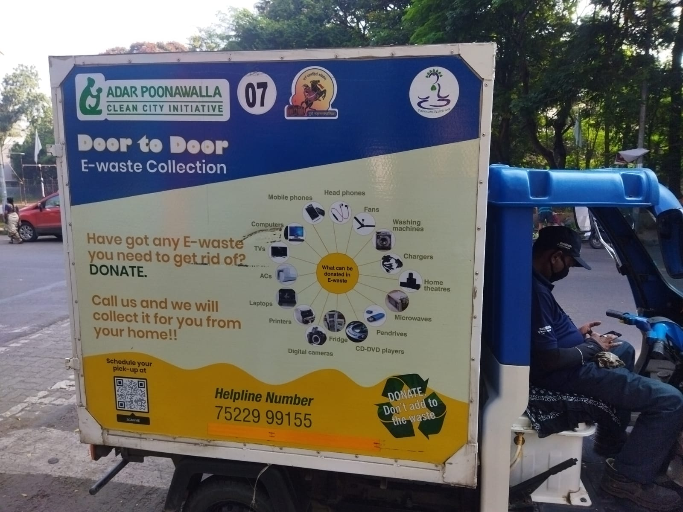
Problem Statement
Agencies and NGOS working on waste collection
There is no link between aggregators and end users, e.g.
User may not be aware of segregation process
Collector does not know where to collect
User does not have solid motivation to recycle

Slide 3

Proposed Solution
Fun Fact
Tesla earned a whopping $1.78 billion in carbon trading
A marketplace for identifying waste, segregate them and suggest to recycle and provide tangible benefits (carbon credit) for recycling
Provide real-time collection center information through geospatial tagging
Provide options to users to connect to various stakeholders and options to recycle
Gives an estimation based on the images added by user to categorize the type of waste and estimate the carbon credits
Based on that user would be able to earn the credits which can provide credibility to users and can be traded in future for real value

Slide 4
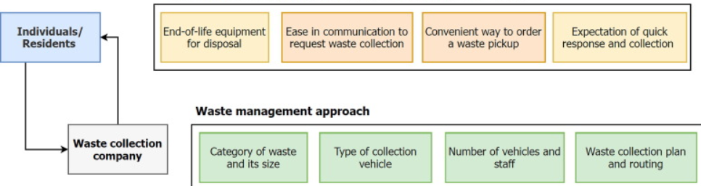
Solution

Slide 5





Tech Stacks
VGG16
Deep Learning

Slide 6

Future Prospects
Onboard various agencies for recycling
Segregate multiple type os images from single frame
Take video data for processing
Providing a real-time trading platform for carbon trading

Slide 7
Code Repository
https://github.com/jayant2014/Call-For-Code-Sustainability

